Slide 1


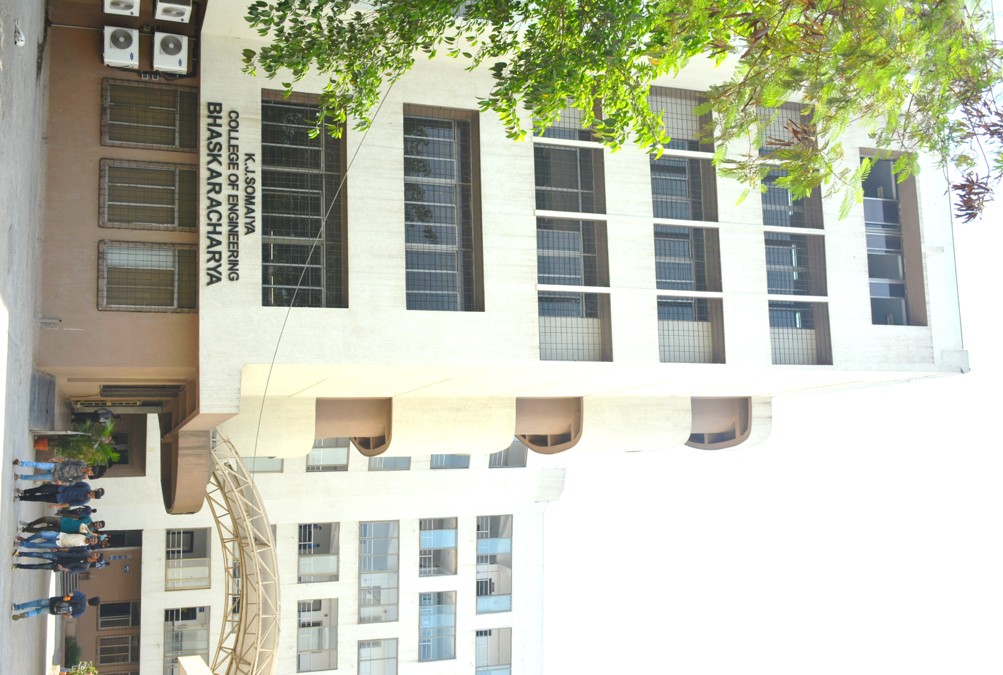
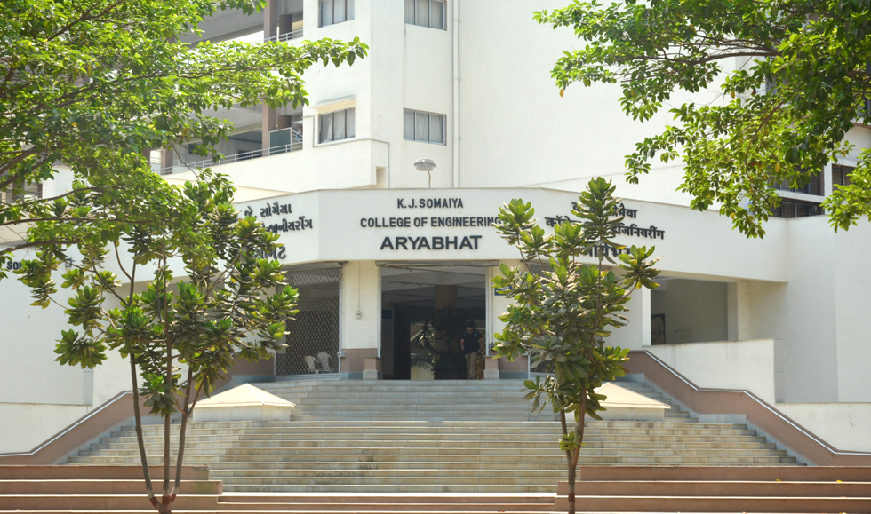
MediSlot
Smart Medical Appointment Schedueler
16010123012- Aaryan Sharma
16010123017- Aditey Kshirsagar
16010123023- Aditya Baheti
1

Slide 2

Problem Definition
Booking doctor appointments manually is time-consuming and inefficient.
Patients face difficulty finding available doctors at suitable times.
Doctors struggle to manage schedules and overlapping bookings.
No unified system exists to handle appointments, notifications, and patient history in one place.
MediSlot solves this by providing a digital, automated, and user-friendly appointment system.
2

Slide 3
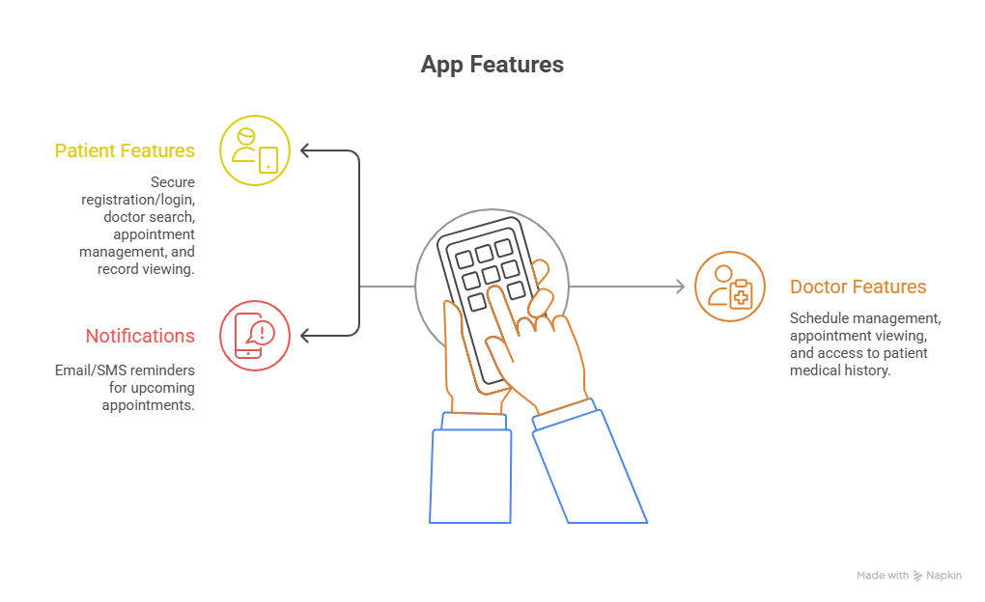
Functionality Provided
For Patients:
Register/Login securely
Search doctors by specialization
Book, cancel, or reschedule appointments
View appointment history and medical records
For Doctors:
Manage schedules and availability
View upcoming appointments
Access patient medical history
Notifications:
Email/SMS reminders for upcoming appointments
3

Slide 4
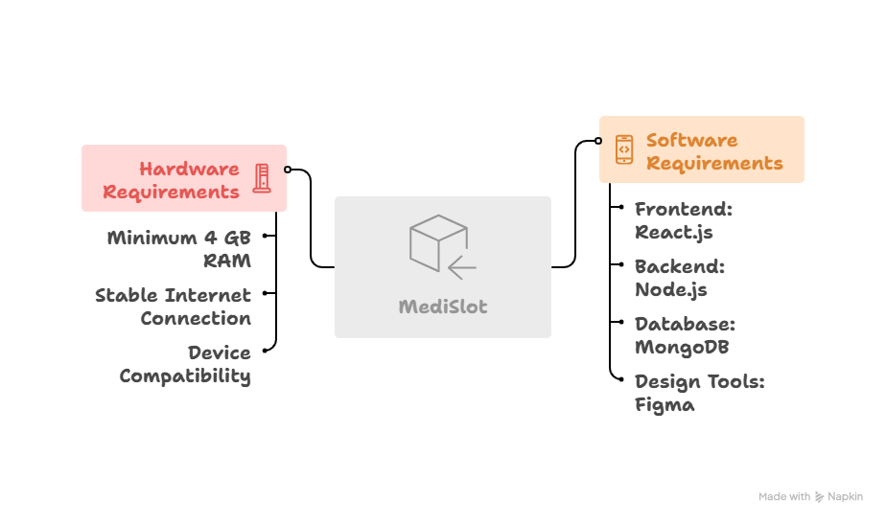
Software & Hardware Requirements
Software Requirements:
Frontend: React.js
Backend: Node.js
Database: MongoDB
Design Tools: Figma
Hardware Requirements:
Minimum 4 GB RAM system
Stable Internet connection
Compatible on PC
4

Slide 5
UML Diagrams
5

Slide 6
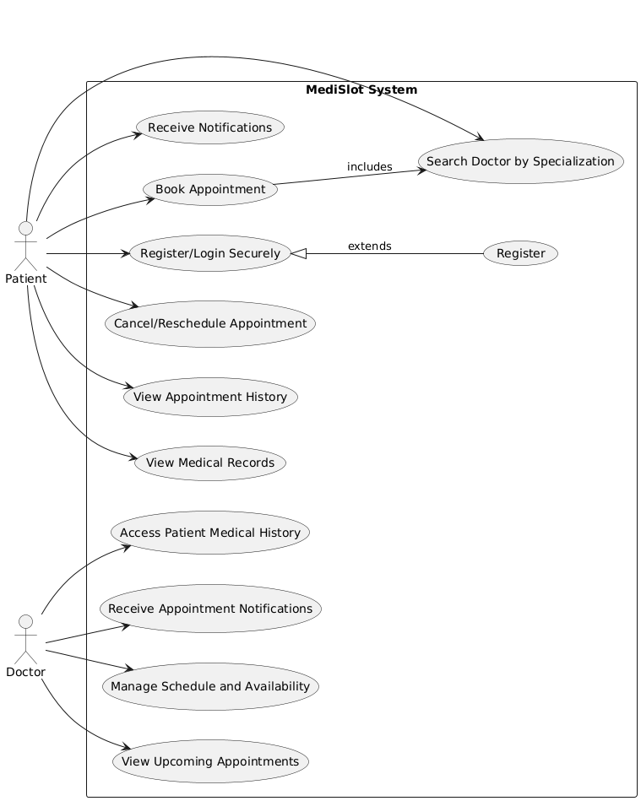
Usecase Diagram
6

Slide 7
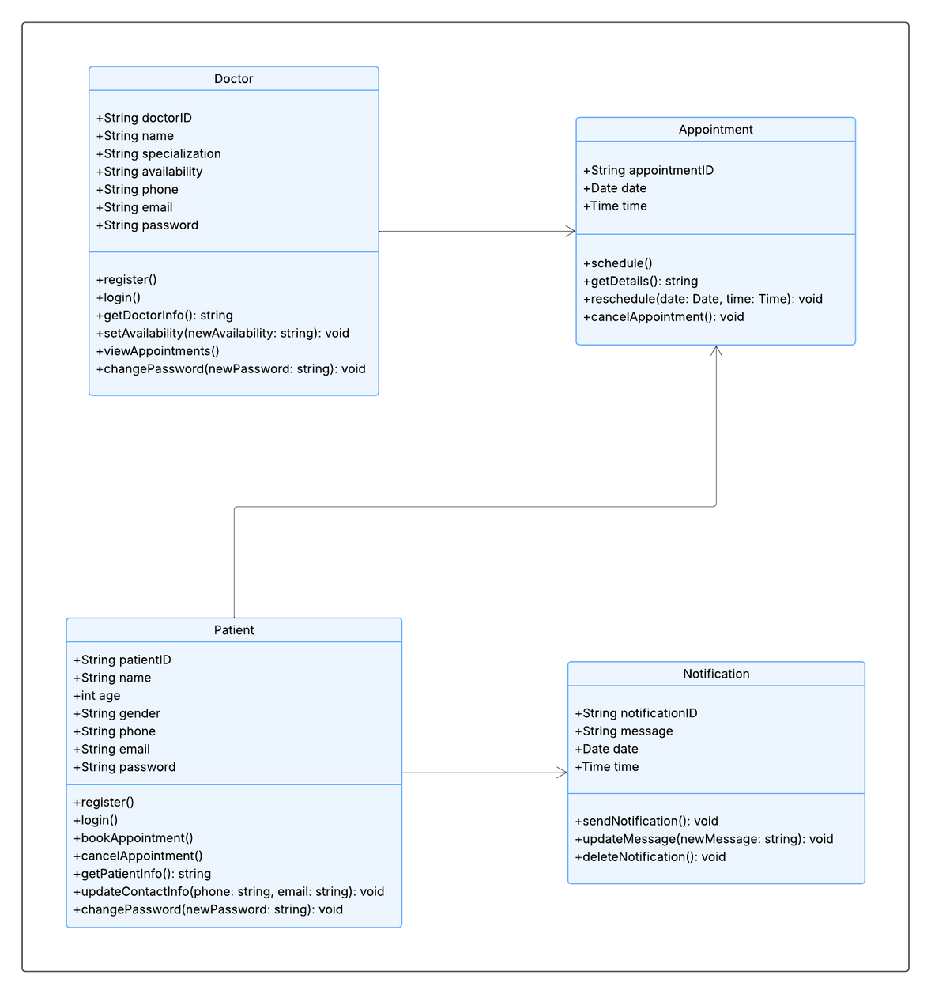
Class Diagram
7

Slide 8
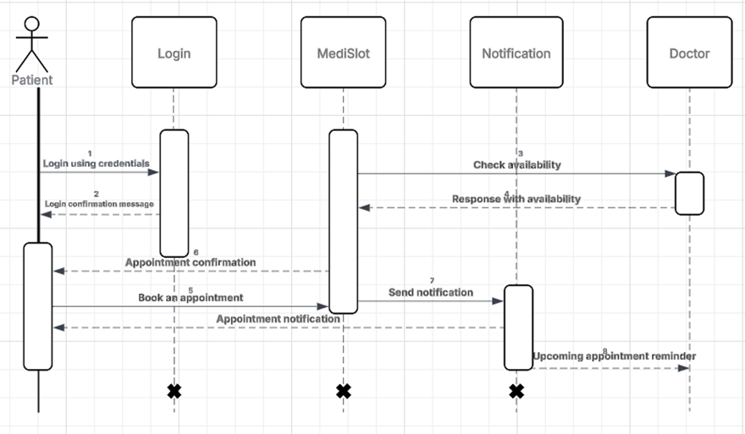
Sequence Diagram
8

Slide 9
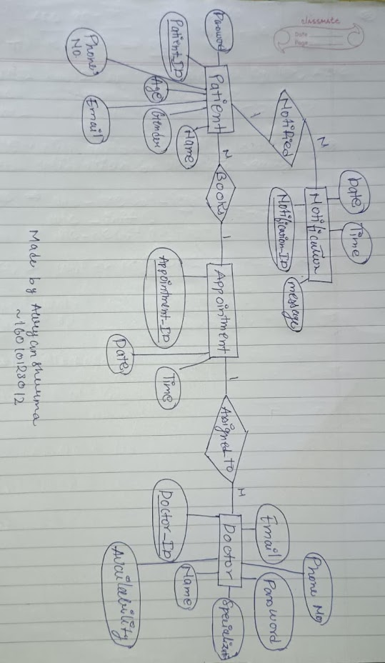
ER Diagram
9

Slide 10
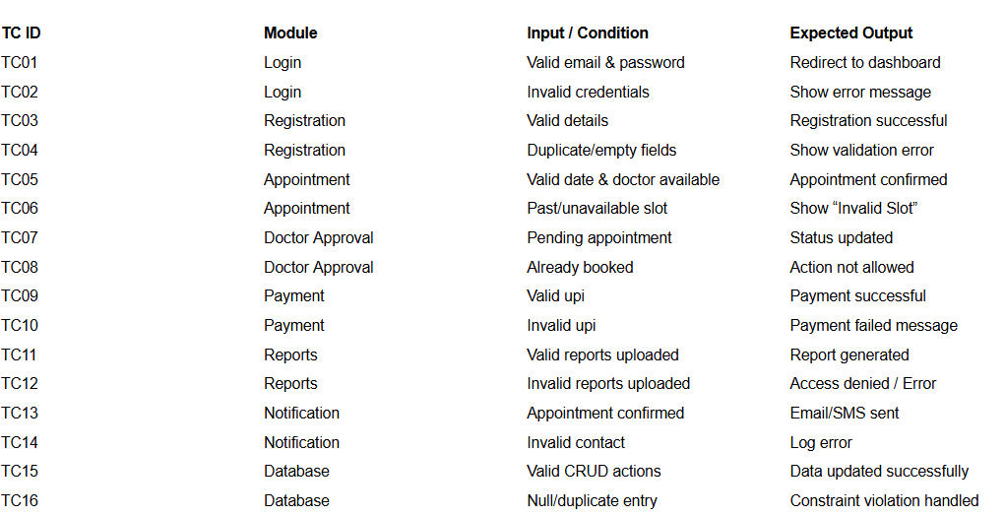
Test Cases
10

Slide 11
User Interface Design
11

Slide 12
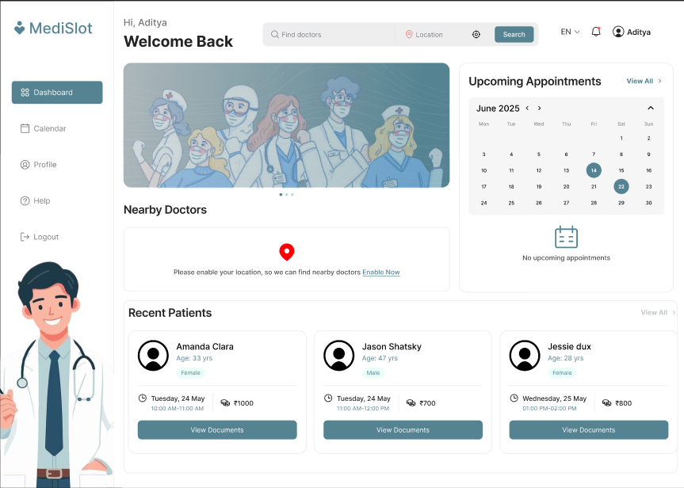
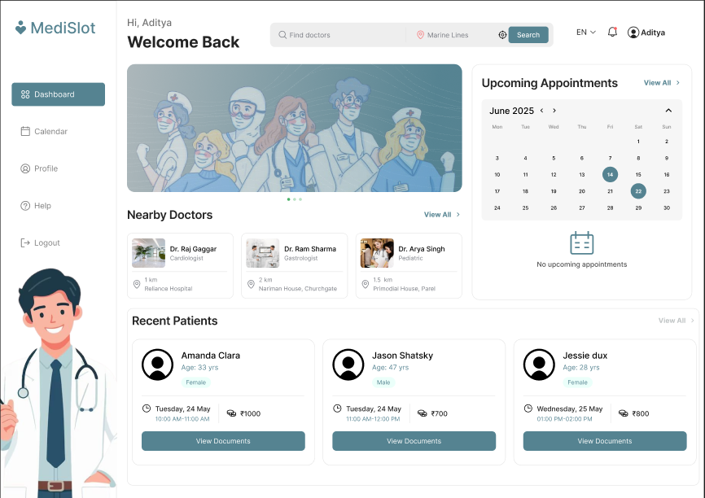
UI Design
12

Slide 13
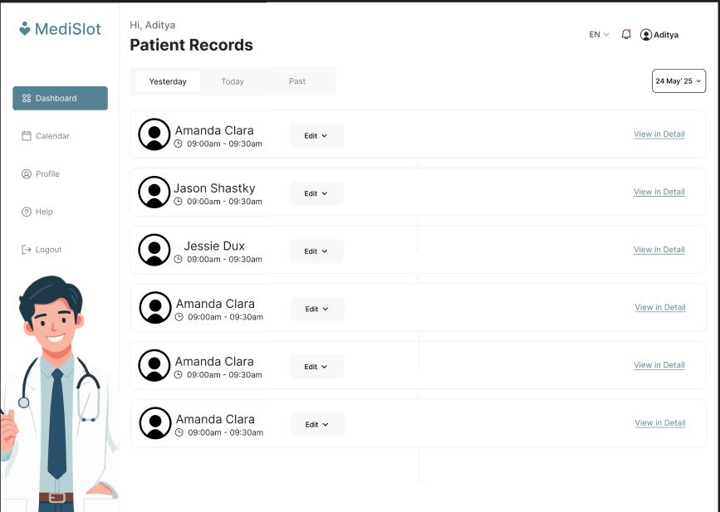
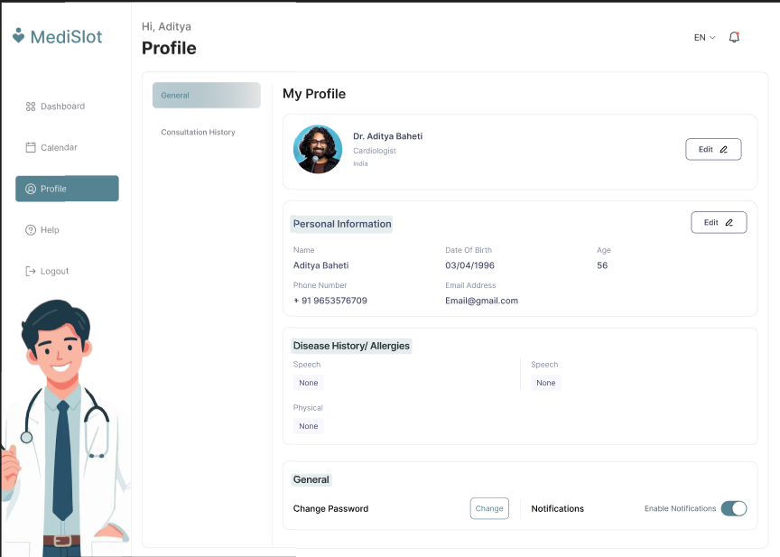
UI Design
13

Slide 14
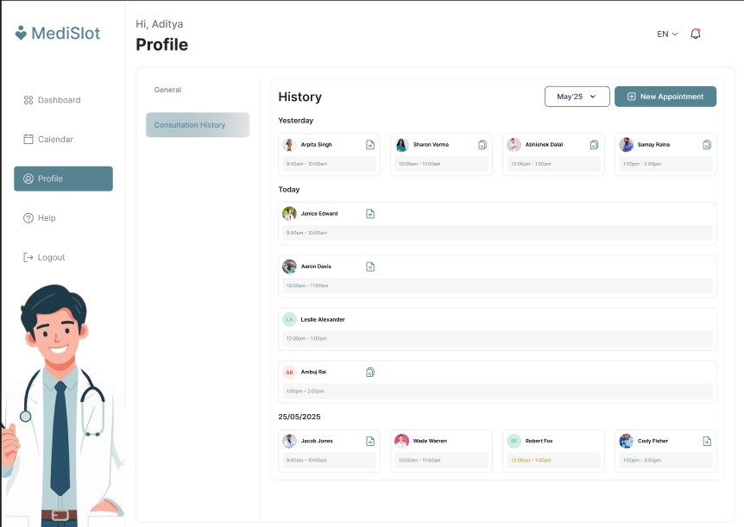
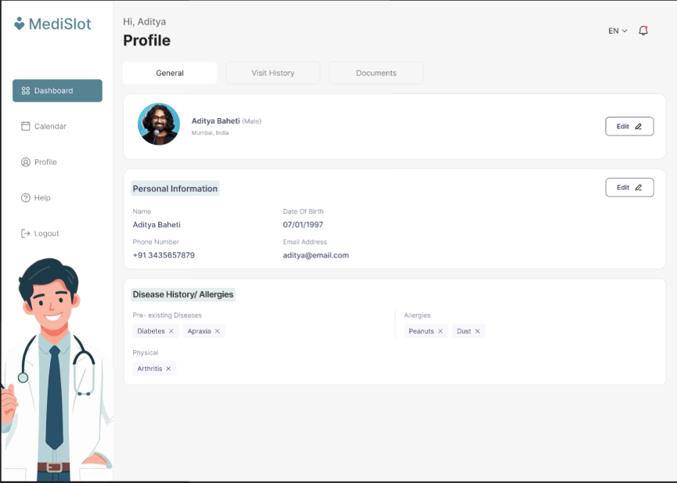
UI Design
14

Slide 15
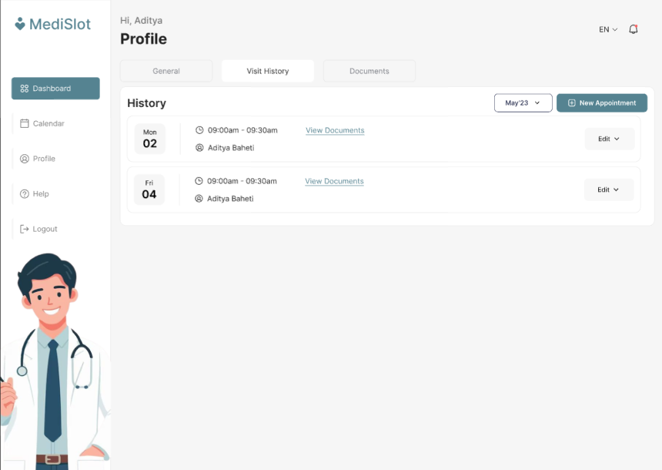
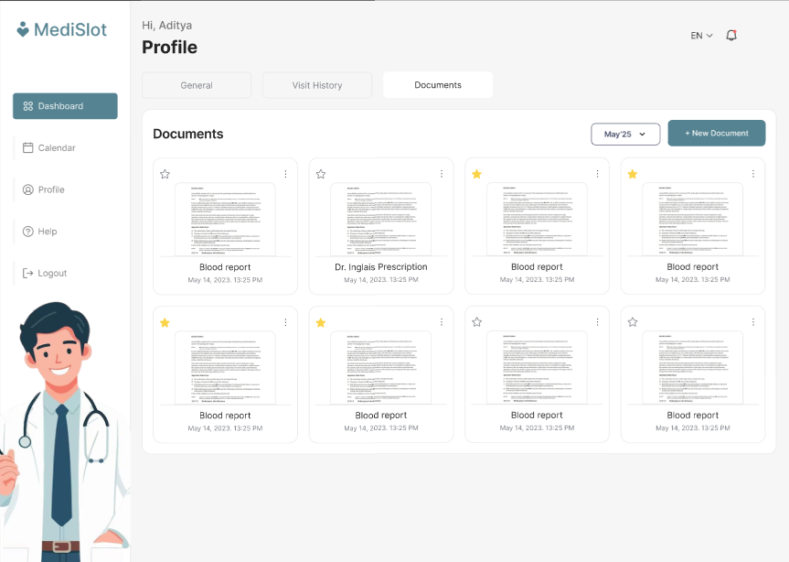
UI Design
15

Slide 16
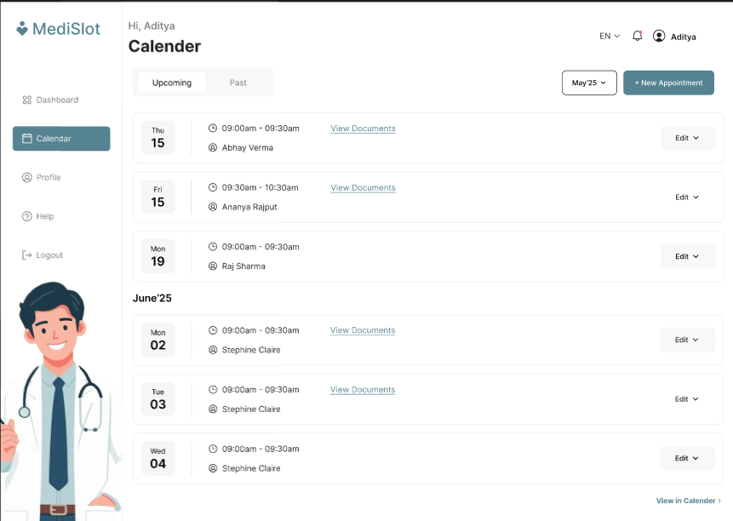
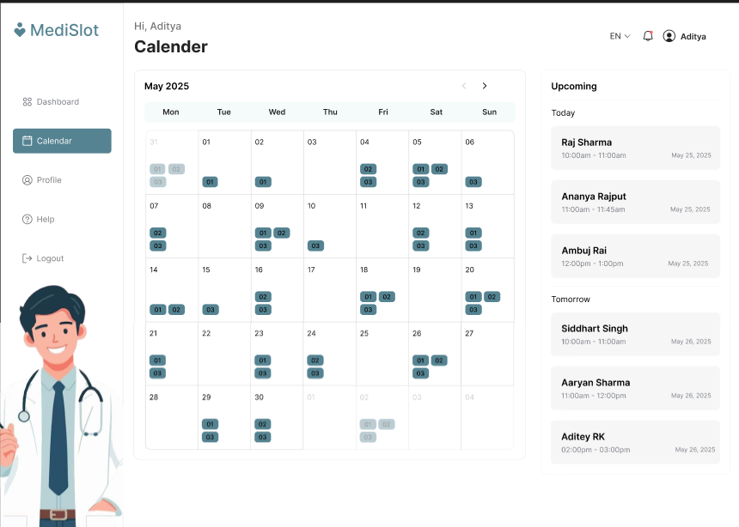
UI Design
16

Slide 17
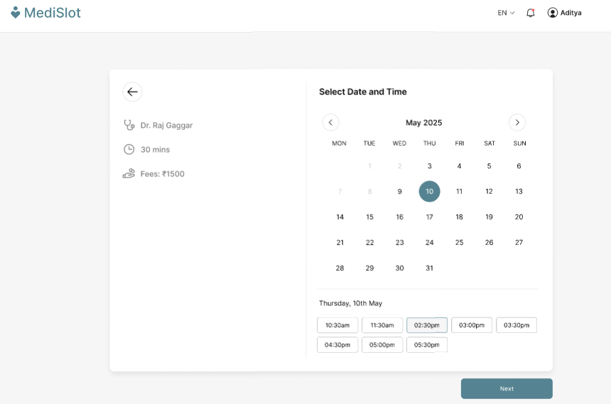
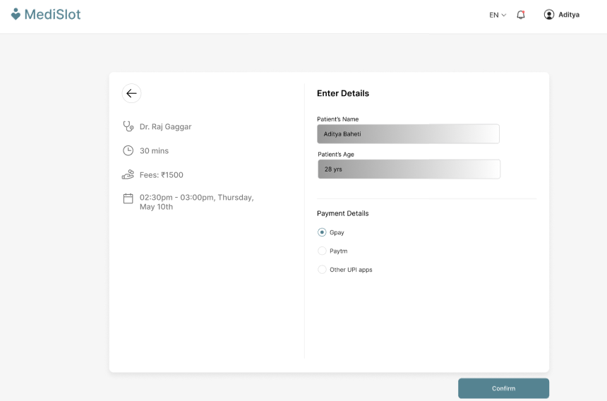
UI Design
17

Slide 18
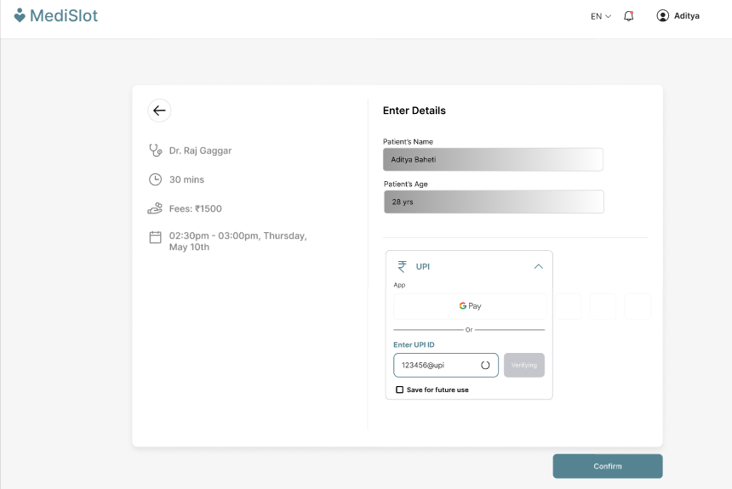
UI Design
18

Slide 19
Software Requirements Specification (SRS)
Initial Scope:
Basic patient-doctor appointment system.
Revised Features:
Added the feature to view patients’ past health history.
Improved security for login and user data encryption.
Enhanced notification system for both email and SMS reminders.
Billing and payment integration.
19

Slide 20
References
Pressman, Roger S. Software Engineering: A Practitioner’s Approach, 8th Edition, McGraw-Hill, 2015.
Calendly - https://calendly.com
Figma - https://www.figma.com
Lucidchart - https://www.lucidchart.com
20

Slide 21
Thank You
21

